Slide 1
IBM Bob Gujarat State level Hackathon Project Submission
“Exploring the Power of Agentic AI with IBM Granite and IBM Bob”

Slide 2

Project Tile – Travel Planner Agent
Domain of Project – Artificial Intelligence (AI) & Generative AI
Student Name | Recent Passport Photo | Email ID | Mobile number [WhatsApp]
Durgesh Kumar |  | durgeshkumar133637@gmail.com | 9559133637
Recommended font style and size:
Font Style: Arial
Font Size (Heading): 28
Font Size (Content): 20

Slide 3
Problem Statement -
Problem Statement No.5- Travel Planner Agent
The Challenge - A Travel Planner Agent is an AI-powered assistant that helps users plan trips efficiently and intelligently. It uses real-time data to suggest destinations, build itineraries, and recommend transport and accommodation options. By understanding user preferences, budgets, and constraints, it tailors personalized travel plans. Integrated with maps, weather updates, and local guides, it ensures a smooth travel experience. The agent can also manage bookings, alert users to changes, and optimize schedules on the go. This smart assistant transforms complex travel planning into a seamless, enjoyable process.
Technology - Use of IBM cloud lite services /IBM Granite is mandatory.

Slide 4
Proposed Solution -
Proposed Solution :
We propose to develop an AI-powered Travel Planner Agent that uses IBM Granite to understand users' travel preferences, budget, destination, duration, and interests, and then automatically generates a personalized travel plan.
The system will provide a simple web interface where users can enter their travel requirements. The backend will process this information using IBM Granite through IBM watsonx.ai and generate a day-by-day itinerary along with estimated expenses, transportation options, accommodation suggestions, weather information, and travel tips.
The application will also allow users to modify their generated itinerary using simple natural-language requests such as “Make my trip cheaper” or “Make Day 3 more relaxed.” The AI will update the plan according to the user's requirements.
The application will be developed using React for the frontend and FastAPI/Python for the backend, with IBM Cloud used for cloud deployment. A demo-data/fallback mechanism will be included so the system remains functional even when external APIs are unavailable.
Key benefits of the proposed solution:
Personalized travel planning using AI
IBM Granite-based itinerary generation
Budget-aware trip planning
Basic weather and travel information
Easy modification of travel plans
Simple and user-friendly interface
IBM Cloud-based deployment
Reduces the time and effort required for manual trip planning

Slide 5
Technology Used
Programming Language: Python, JavaScript
Frontend: React.js, Vite, HTML5, CSS3, Tailwind CSS
Backend: FastAPI (Python)
Artificial Intelligence: IBM Granite via IBM watsonx.ai
Cloud Platform: IBM Cloud
Cloud Deployment: IBM Cloud Code Engine
External API: Weather API for basic weather information
API Communication: REST API
Data Format: JSON
Development Tools: VS Code, Git/GitHub
Containerization: Docker
Core Technologies:
IBM Granite + IBM watsonx.ai + IBM Cloud + React.js + FastAPI + Python

Slide 6
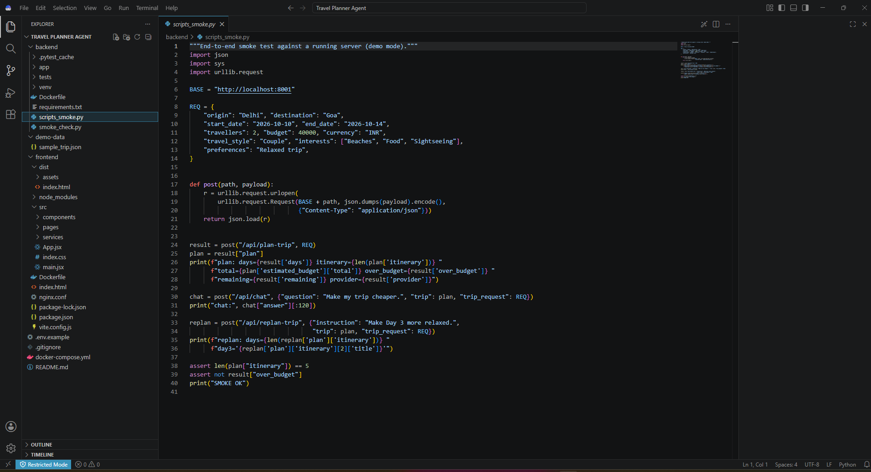
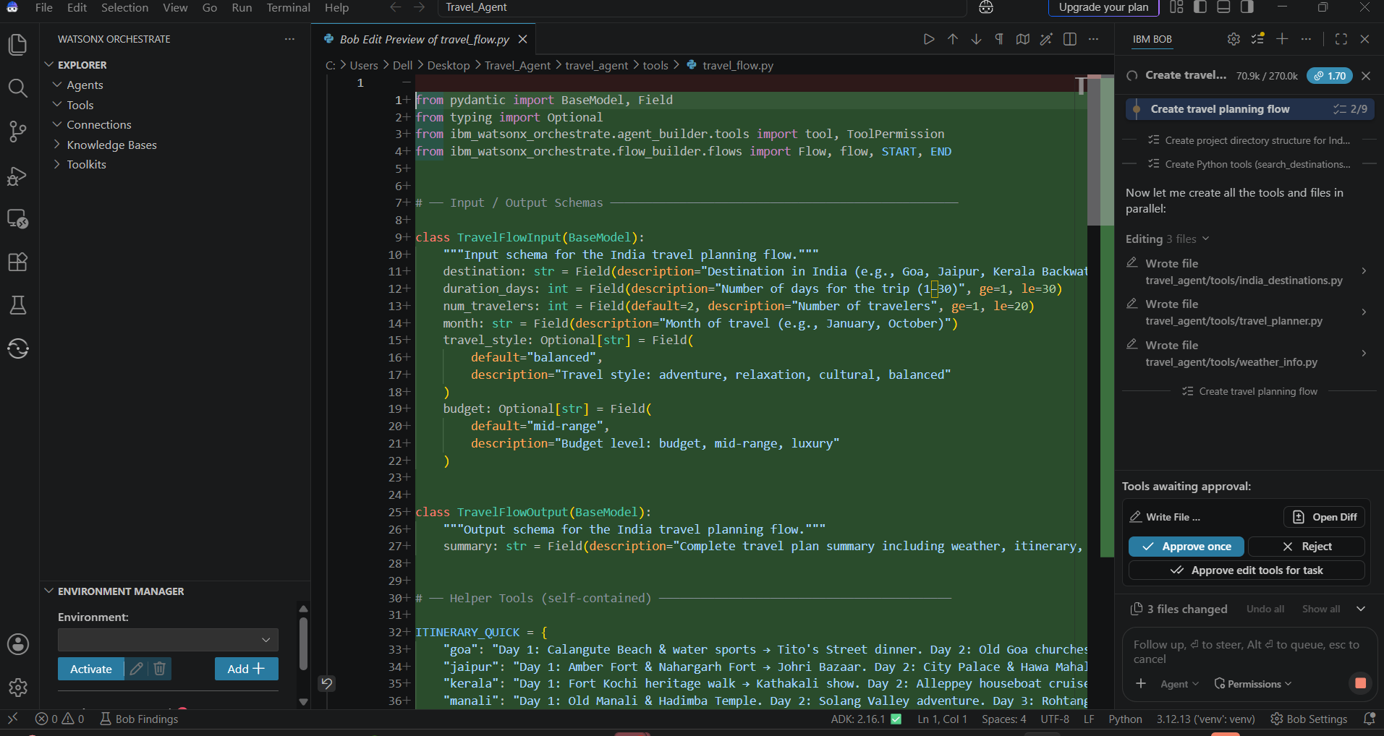
Required Files created using IBM bob -

Slide 7
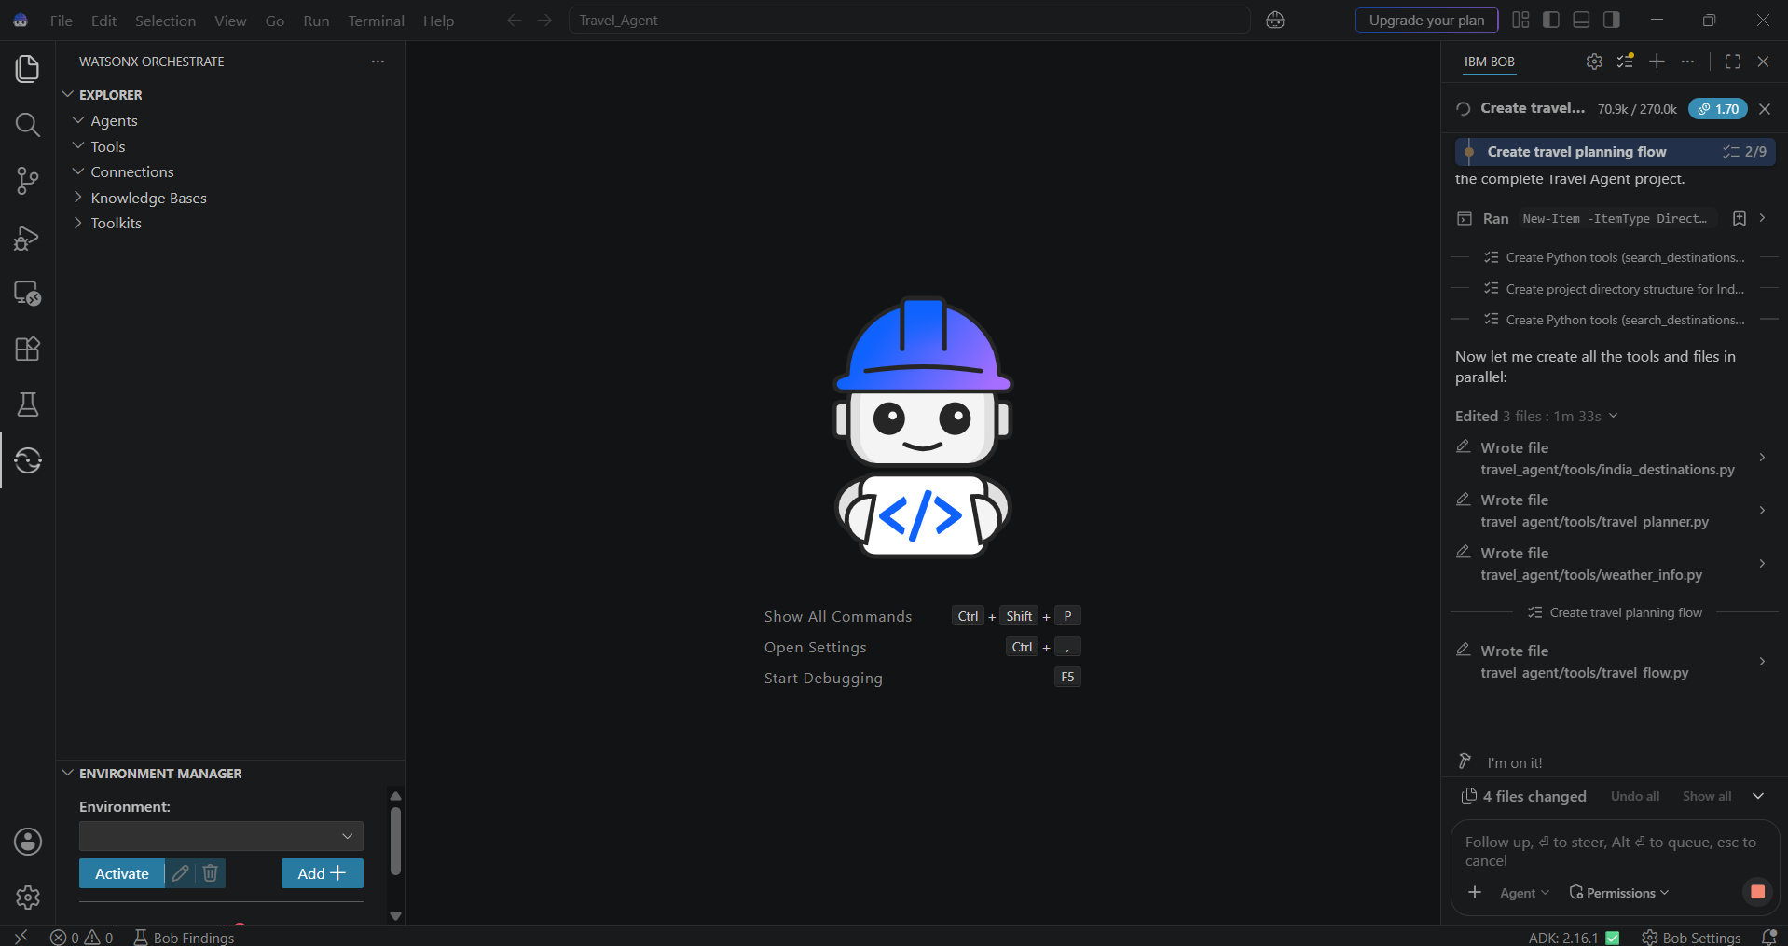
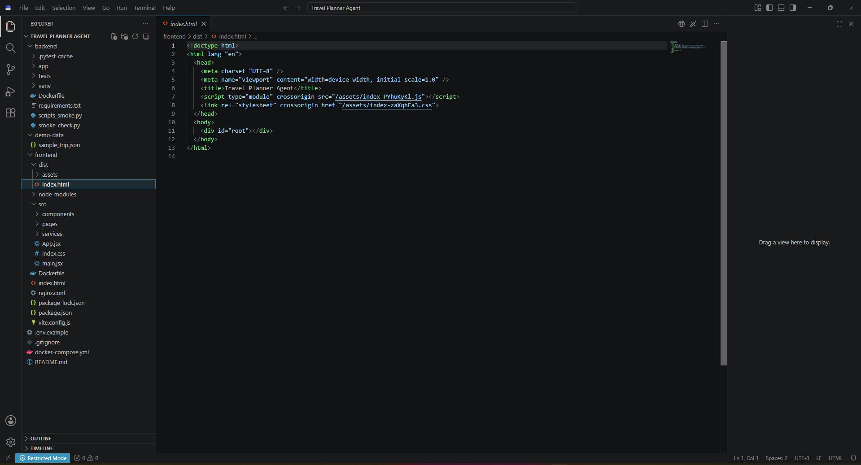
IBM Bob Screenshots:

Slide 8
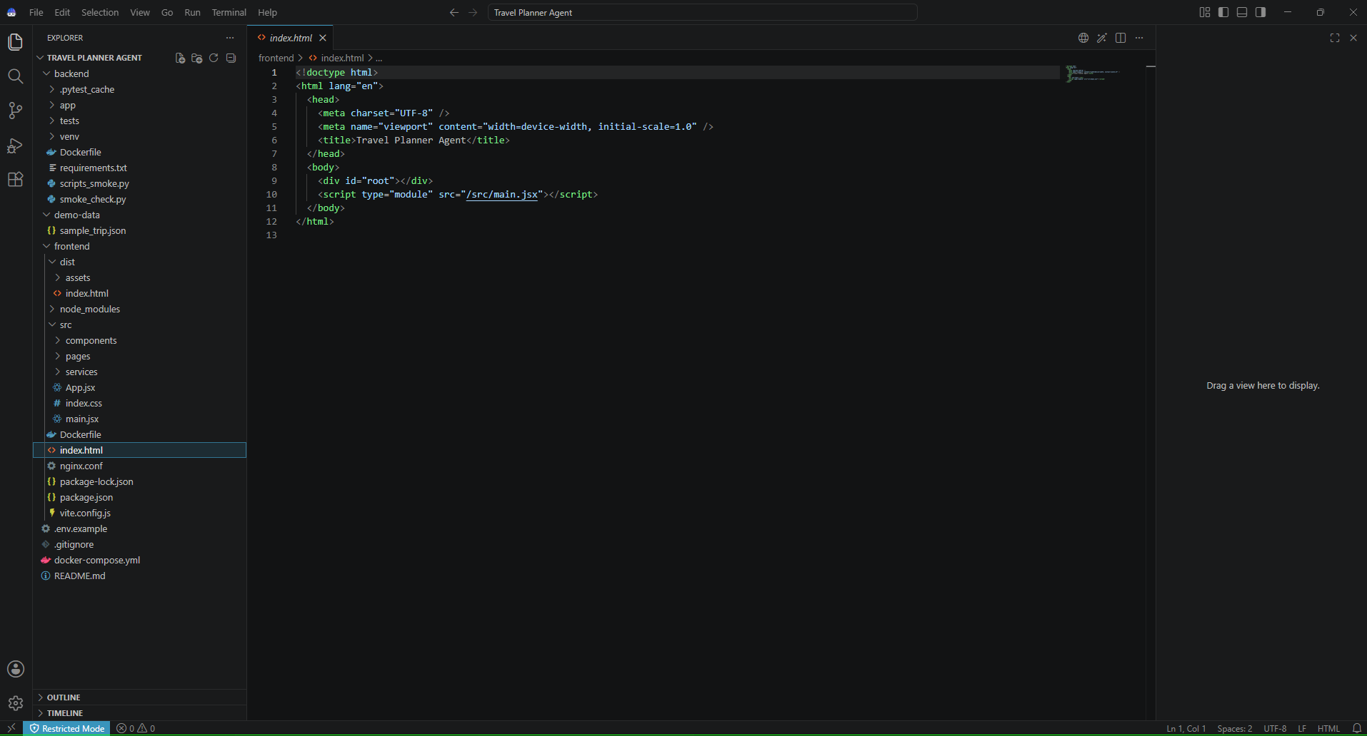
IBM Bob Screenshots:

Slide 9
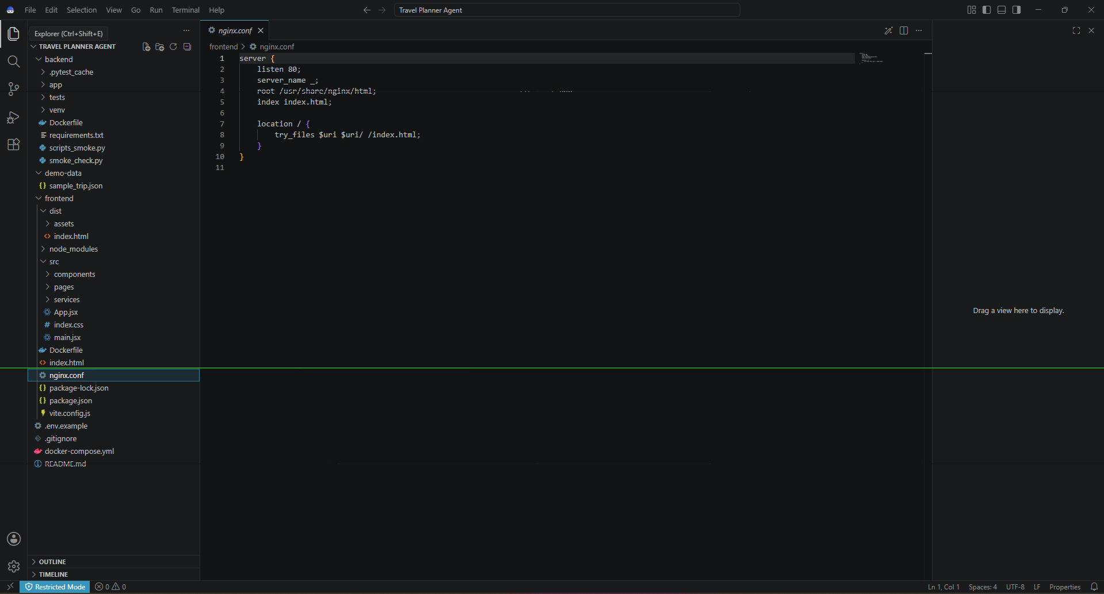
IBM Bob Screenshots:

Slide 10
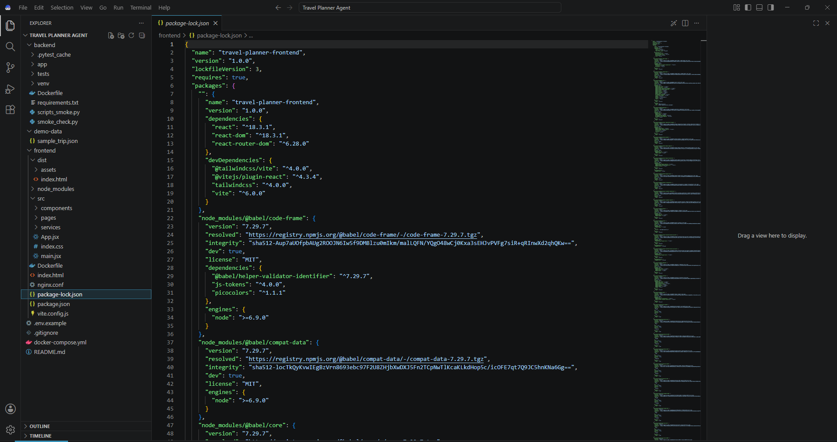
IBM Bob Screenshots:

Slide 11
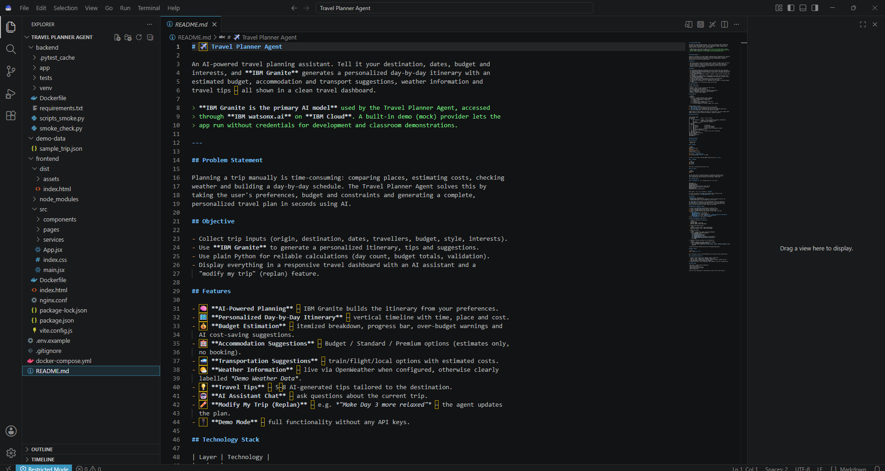
IBM Bob Screenshots:

Slide 12

IBM Bob Screenshots:

Slide 13
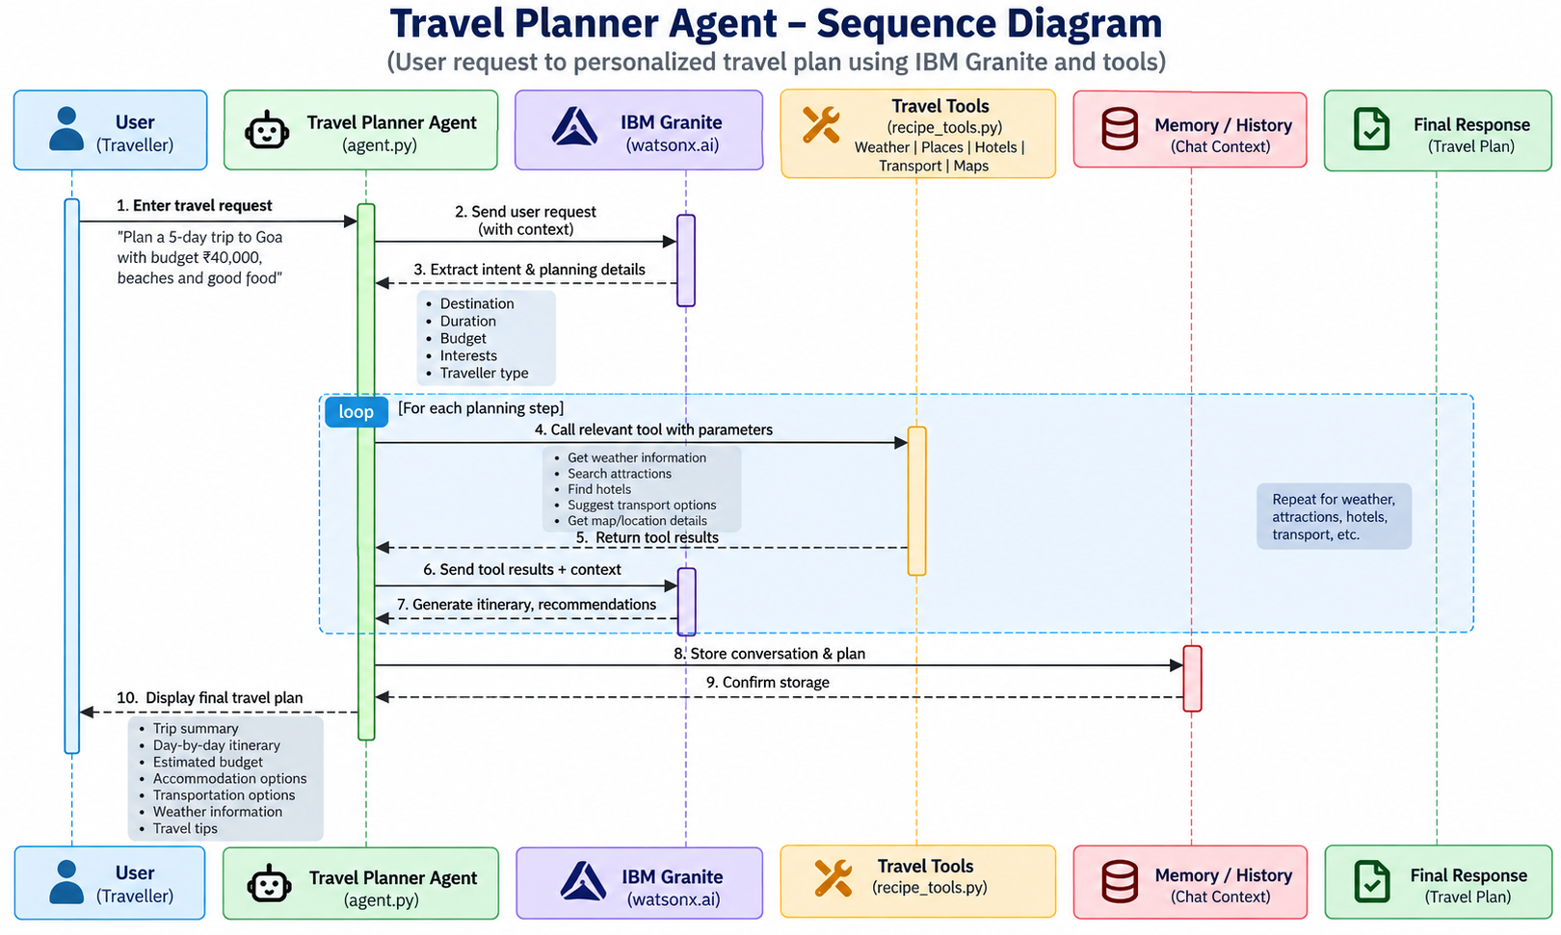
Architecture blueprint for IBM bob:

Slide 14

Role of Agentic AI in the solution
Understands User Requirements
Analyzes destination, budget, duration, number of travellers, interests, and preferences.
Makes Planning Decisions
Determines suitable activities, transportation, accommodation options, and daily schedules based on the user's requirements.
Uses External Tools
The agent can access services such as weather information and travel/place data to improve the generated plan.
Generates Personalized Itinerary
IBM Granite generates a day-by-day travel plan based on the collected information.
Optimizes the Plan
The agent considers the user's budget and preferences and can suggest alternatives when the estimated cost is too high.
Responds to User Changes
Users can request changes such as “Make my trip cheaper” or “Make Day 3 more relaxed.” The agent uses the existing trip context to generate an updated plan.
Provides Explainable Recommendations
The agent explains why particular destinations, activities, or transportation options are recommended.

Slide 15
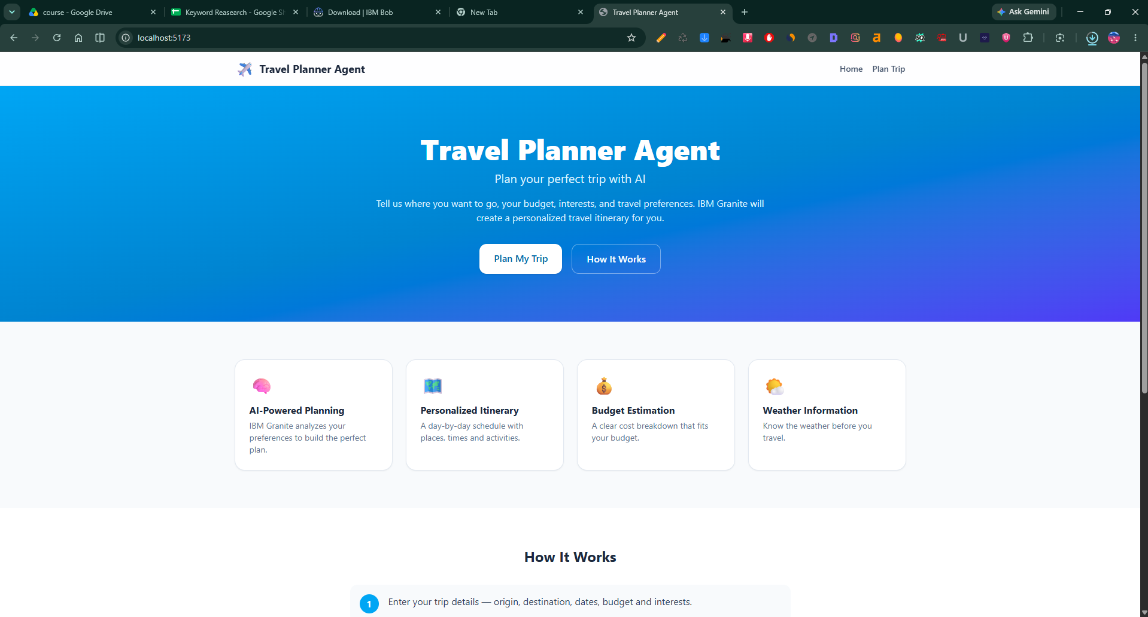
Project Output Screenshot
Please put IBM Bob output screenshots with 2-3 prompts.
You can take 2-3 more slides for each screenshot
·
·
·

Slide 16
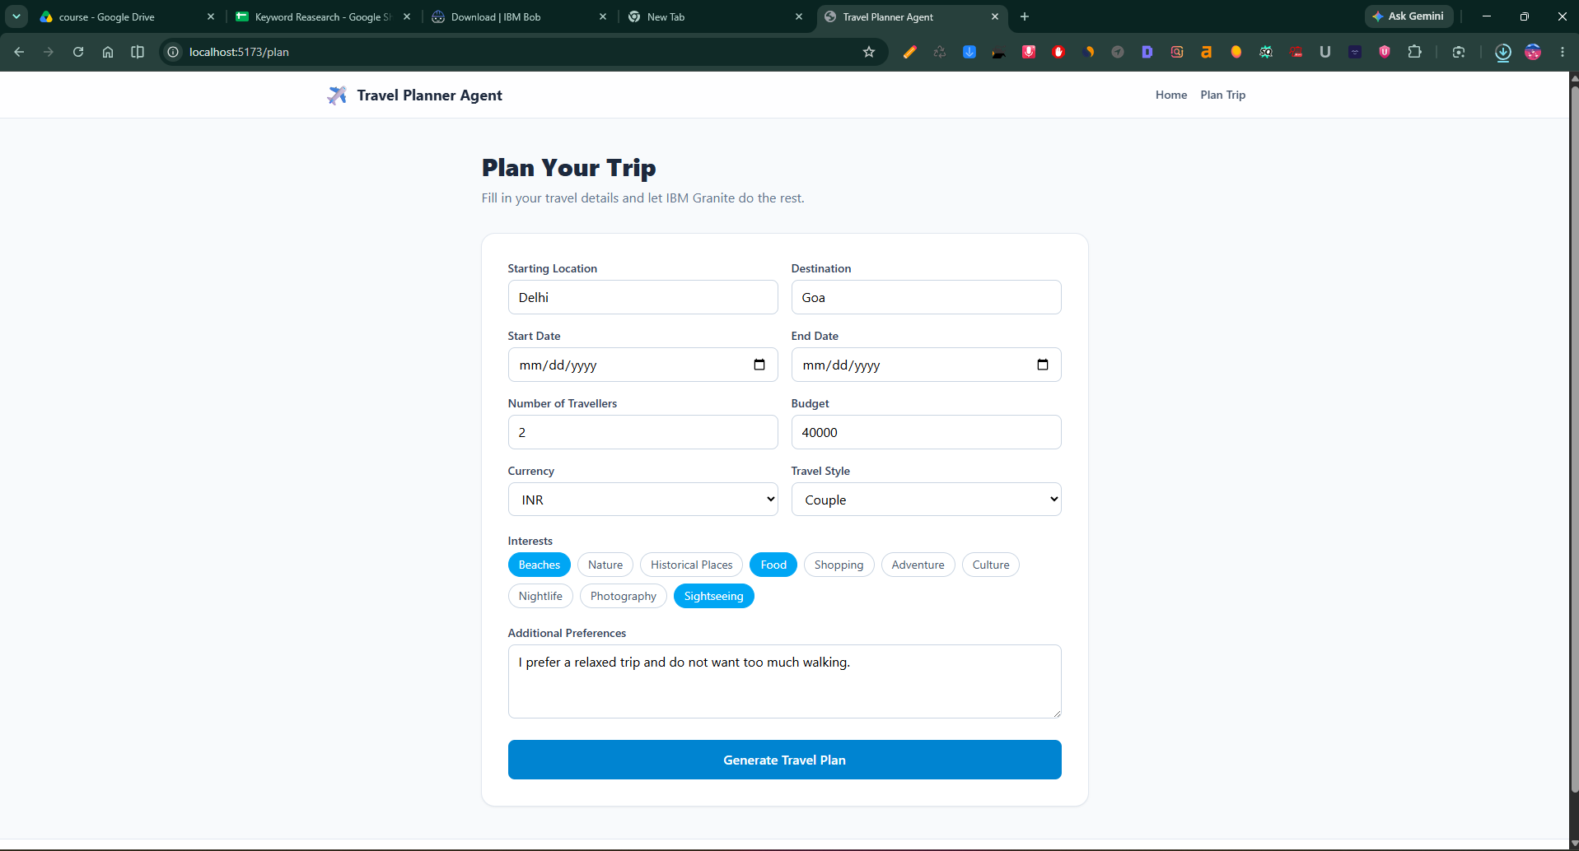
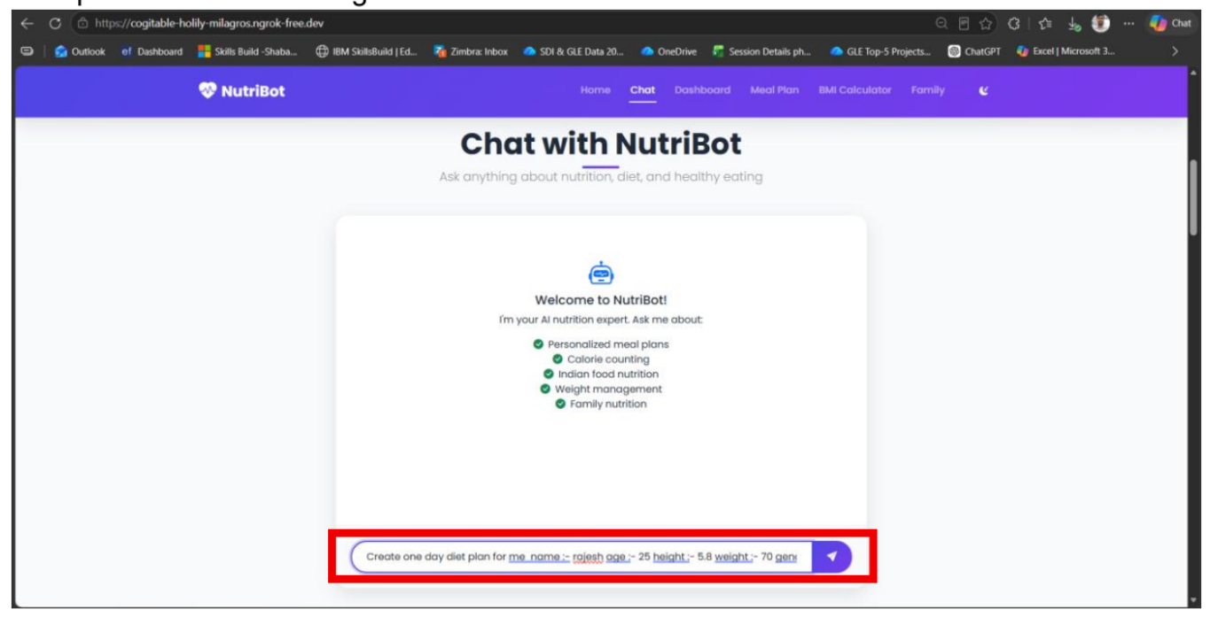
Project Output Screenshot
Please put IBM Bob output screenshots with 2-3 prompts.
You can take 2-3 more slides for each screenshot
·
·
·

Slide 17
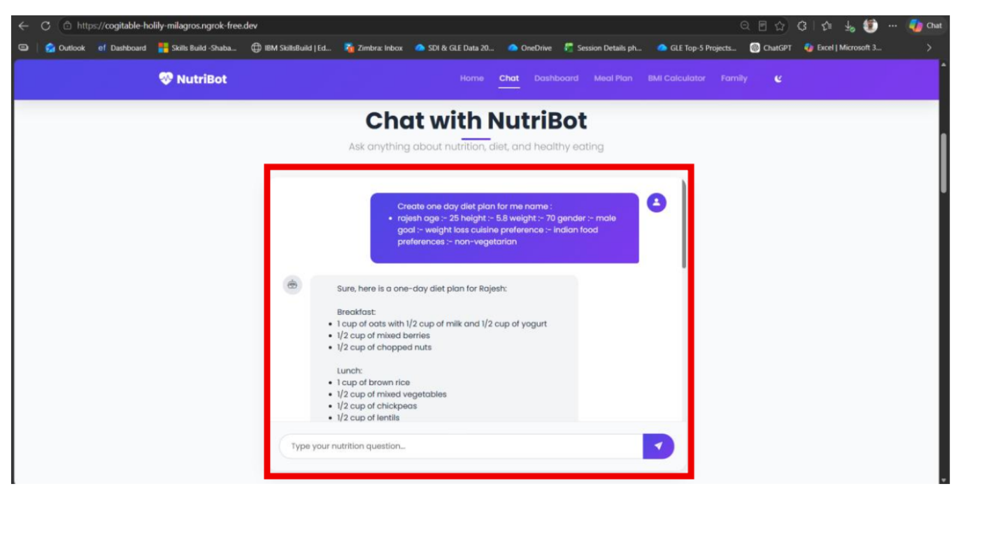
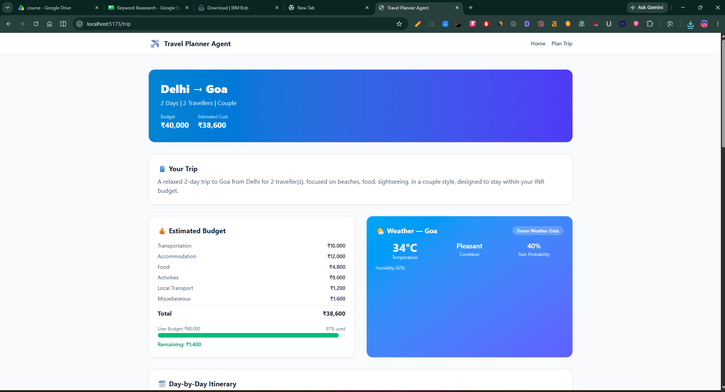
Project Output Screenshot
Please put IBM Bob output screenshots with 2-3 prompts.
You can take 2-3 more slides for each screenshot
·
·
·

Slide 18
The Wow Factor Behind Your Project
AI-Powered Travel Planning: IBM Granite understands the user's requirements and generates a personalized itinerary.
Personalized Recommendations: The system considers budget, duration, interests, number of travellers, and travel style.
Budget-Aware Planning: The application estimates trip expenses and checks whether the plan fits within the user's budget.
Context-Aware Planning: Weather and travel information can be considered when creating suitable activities.
AI-Based Replanning: Users can request changes such as "Make my trip cheaper" or "Make Day 3 more relaxed," and the AI can modify the itinerary.
Agentic Decision Making: The system goes beyond simple question answering by understanding the travel goal, using available tools and data, and creating a complete travel plan.
IBM Cloud Integration: The project demonstrates practical implementation of IBM Granite and IBM Cloud.
Simple User Experience: Users can get their major travel-planning information in one place instead of manually searching multiple sources.
·
·
·

Slide 19
Novelty and Uniqueness
AI-Based Personalized Planning: The system creates travel plans according to individual preferences, budget, duration, interests, and traveller type.
Natural-Language Trip Planning: Users can describe their requirements in normal language instead of filling out complex travel-planning forms.
Agentic AI Approach: The system does not only answer travel questions. It analyzes the user's goal, processes relevant information, and generates a complete travel plan.
Budget-Conscious Itinerary: The system considers the user's available budget while generating the itinerary and provides alternatives when the estimated cost is high.
Dynamic Itinerary Modification: Users can modify their plans through simple instructions such as "reduce my budget" or "make the trip more relaxed," and IBM Granite generates an updated plan.
Combination of AI and External Data: The project combines IBM Granite with weather and travel information to make recommendations more useful and context-aware.
Explainable Recommendations: The system provides reasons for recommending particular activities, transportation options, or accommodation categories.
IBM Granite and IBM Cloud Integration: Unlike a generic AI travel chatbot, the project demonstrates the practical use of IBM Granite as the intelligence layer and IBM Cloud as the deployment platform.

Slide 20
Future Scope
Real-Time Booking and Notifications
The system can be extended to integrate real-time flight, hotel, and transportation booking APIs, along with notifications for delays, cancellations, and schedule changes.
Advanced Personalization and Mobile Application
Future versions can learn from users' previous trips and preferences to provide smarter recommendations and can be extended into a mobile application with GPS-based suggestions and location-aware travel assistance.
·
·
·

Slide 21
Git Hub Link
· Please create public github repository (Enable Add README button while creating repository) with format –
Please test and Paste the working Github URL –
https://github.com/Durgeshkumar3637/AI-powered-Travel-Planner-Agent
·
·
·

Slide 22
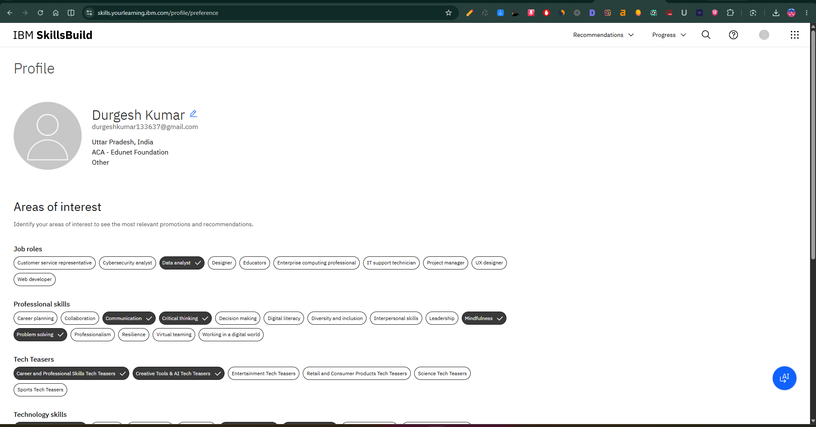
Skills build profile screen shot

Slide 23
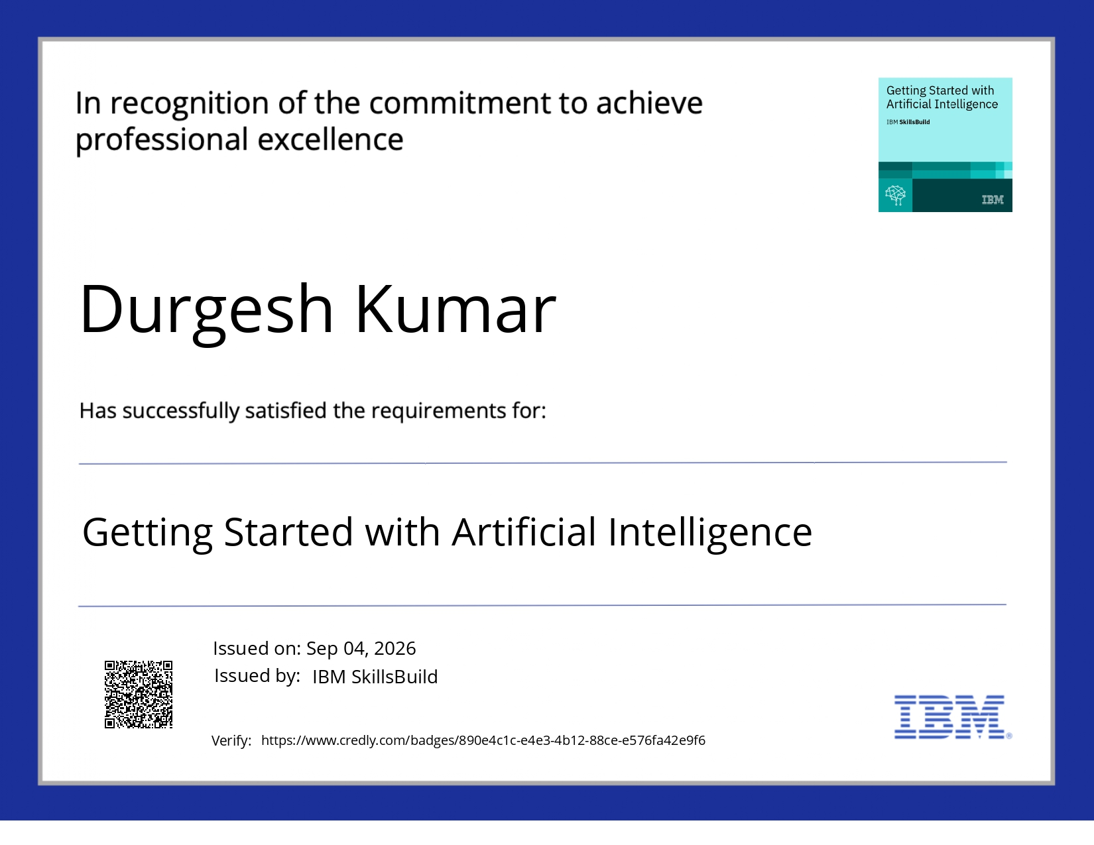
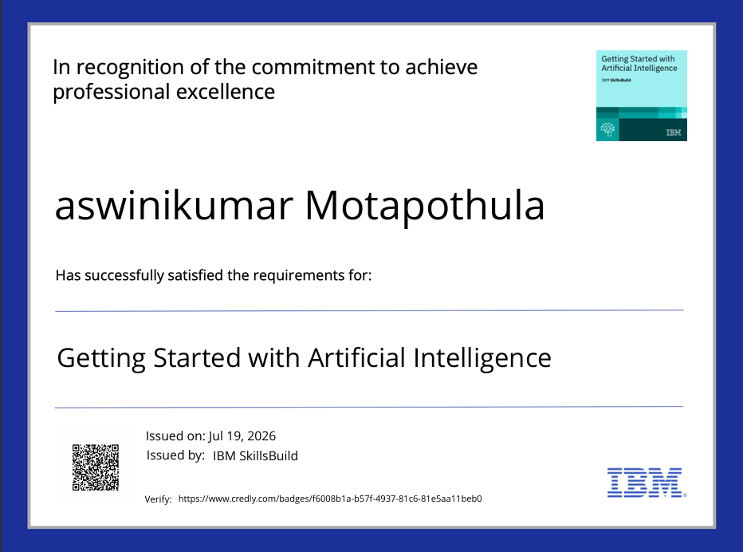
Certificates Earned:
Getting Started with Artificial Intelligence

Slide 24
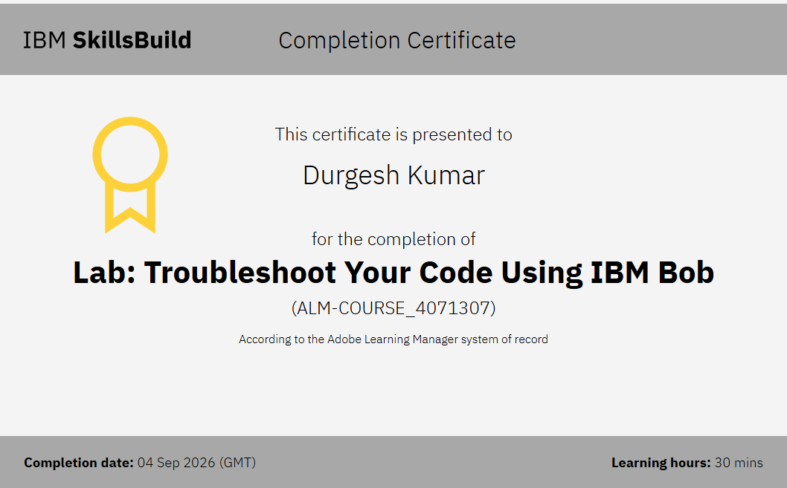

Certificates Earned:​
Add your IBM BOB Certificate

Slide 25


